Slide 1

Supply Chain Management
01
06
02
05
04
03
Team Members:
Anushree Wagh
Fiza Machchhar
Kartik Agrawal
Group 5
Project P-520

Slide 2
Introduction
Supply chain management (SCM) is the discipline that manages the flow of supplies through all of the stages of a production cycle.
It involves the oversight and management of the flow of goods, information and finances as they move from supplier to manufacture to wholesaler to retailer to consumer.
Efficient SCM ensures timely delivery of products, reduces costs, and improves customer satisfaction.

Slide 3
Problem Statement
Total Sales(MTD,QTD,YTD)
Product Wise Sales
Sales Growth
Daily Sales Trend
State Wise Sales
Top 5 Store Wise Sales
Region Wise Sales
Total Inventory
Inventory Value
Over stock, Out Stock & Under stock
Purchase Method Wise Sales

Slide 4
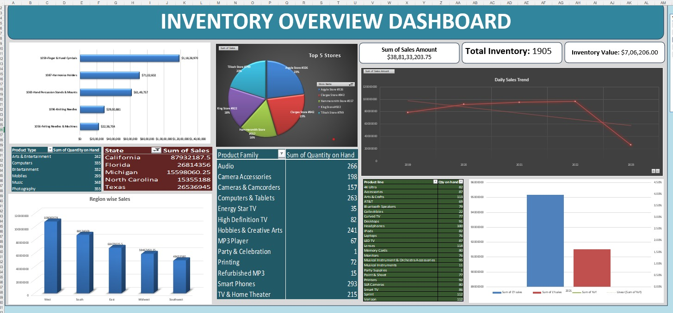
Excel Dashboard

Slide 5
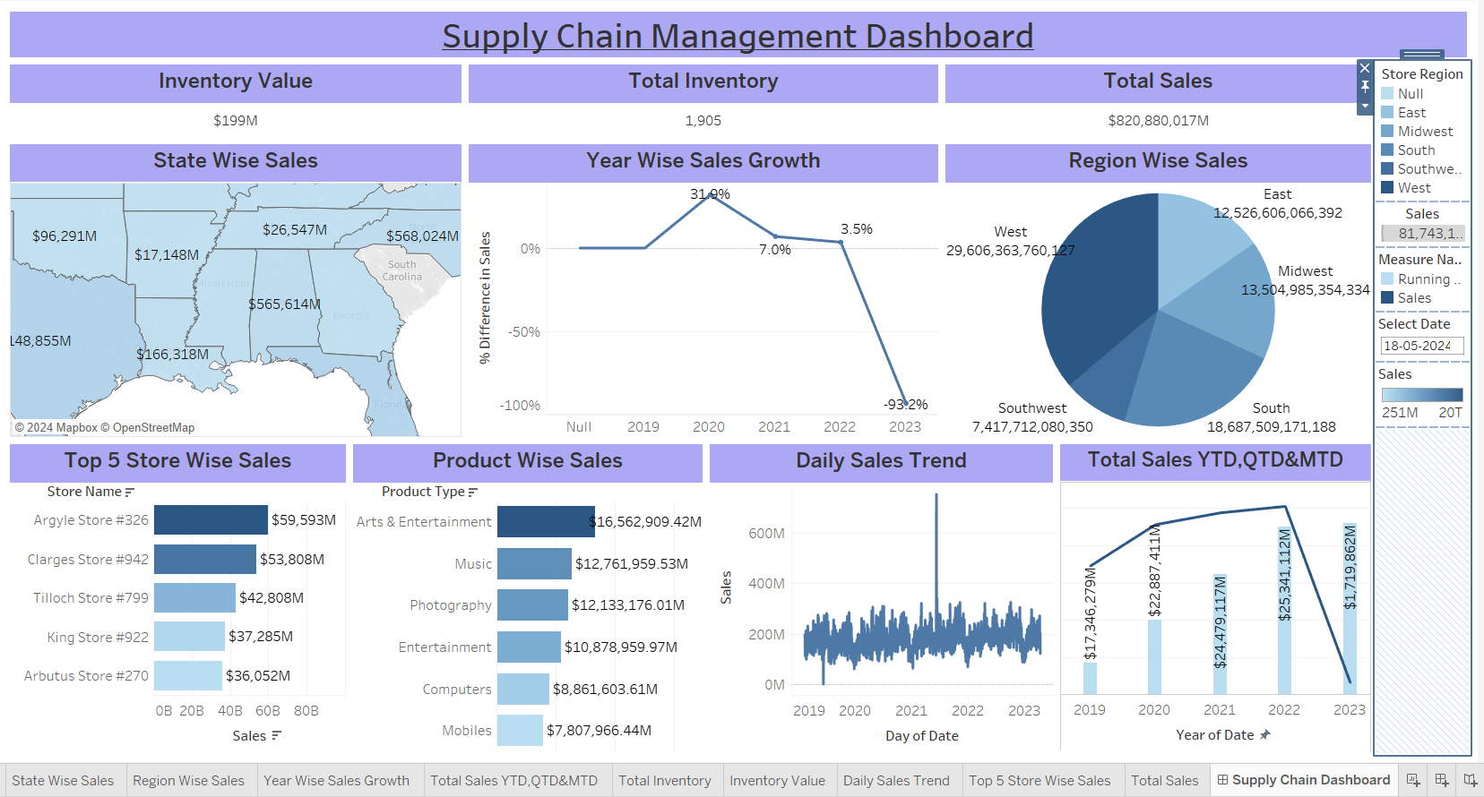
Tableau DASHBOARD

Slide 6
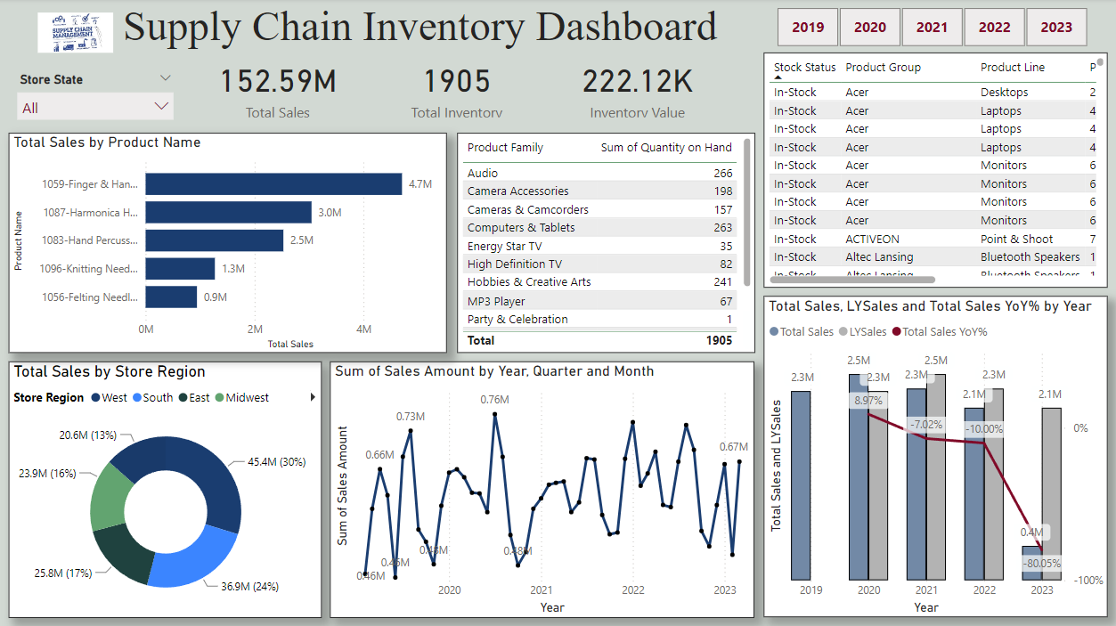
Power BI DASHBOARD

Slide 7
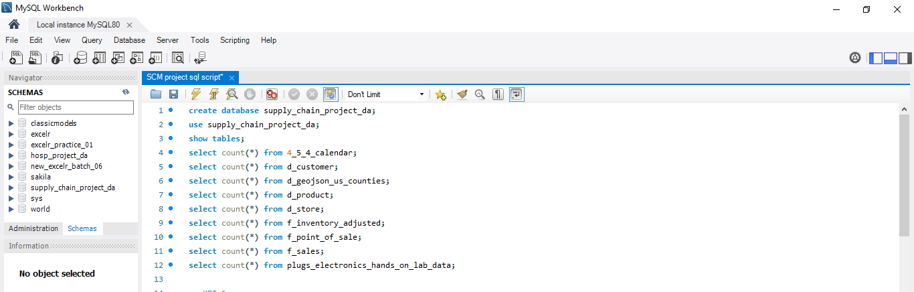
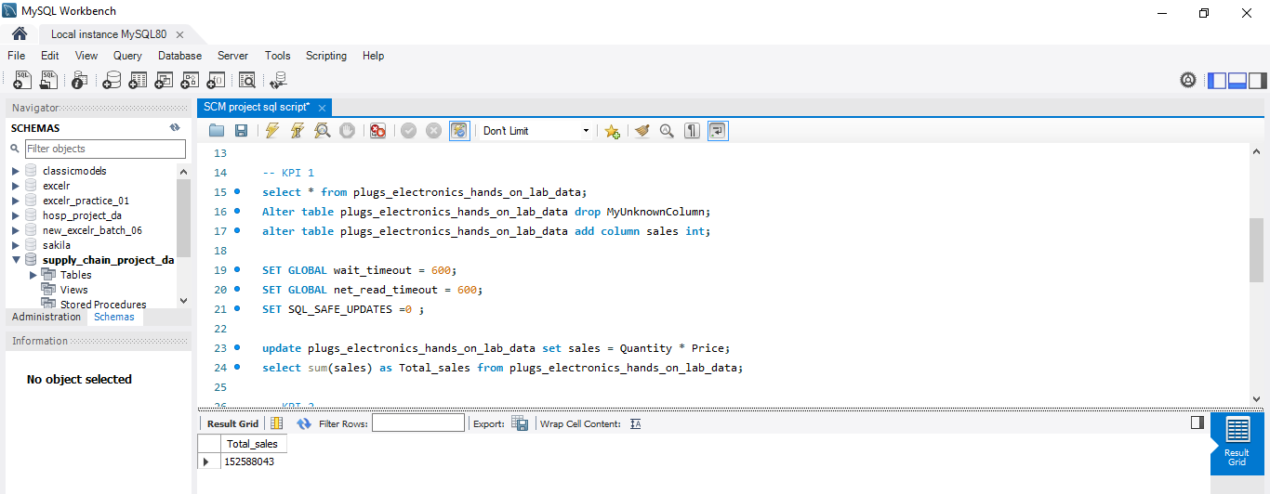
SQL Script

Slide 8
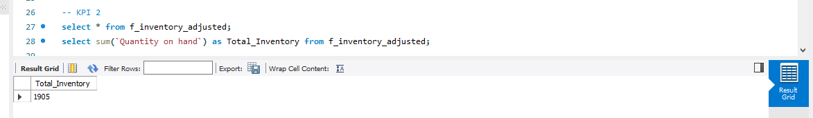
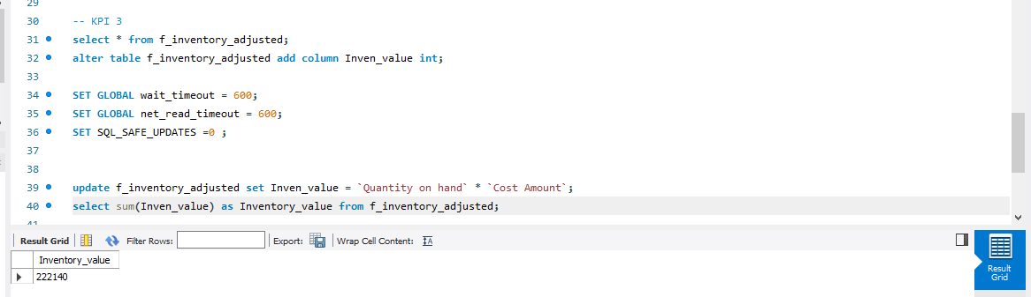

Slide 9
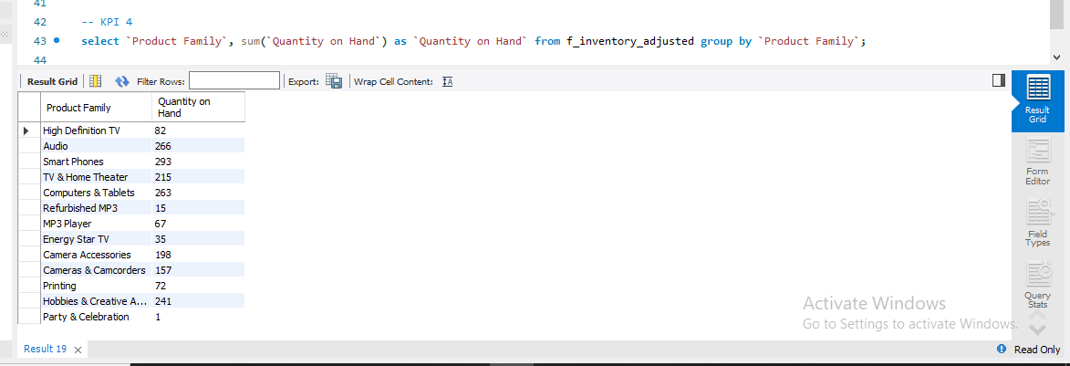

Slide 10
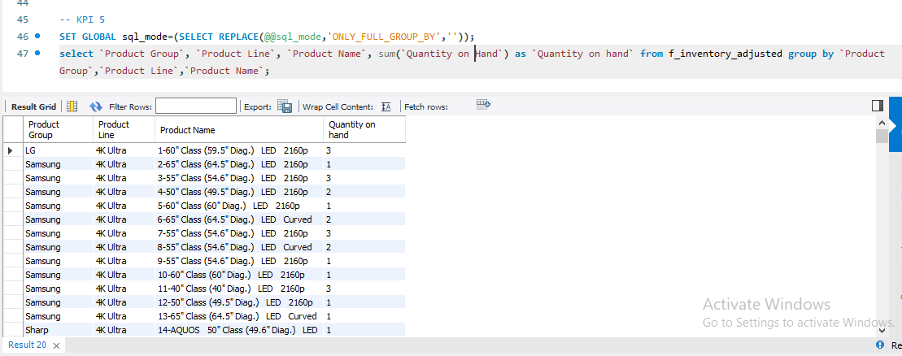

Slide 11
Key insights
A supply chain management (SCM) data analytics project can significantly enhance operational efficiency and strategic decision-making by providing key insights into various aspects of the supply chain.
It helps to identify and focus on which area, product is performing good.
Total Sales is 410.44T (trillion).
Arts and Entertainment has highest product wise sales and Mobiles have the lowest sales.
Sales growth is highest in 2020 and has a huge downfall in 2023.
California has the highest sales.
We also have analyzed the Top 5 store sales.
The West region has the highest sales.

Slide 12
THANK YOU

